Slide 1

Tessellations in lower secondary school classes
Conference on Computer Algebra and Dynamic Geometry Systems in Mathematics Education
7-10 September 2016, Târgu Mureș, Romania
Martin Günzel,
Tereza Suchopárová, Helena Binterová

Slide 2
Pupils do not understand to mathematical language. However, we can not separate mathematics from its own language.
František Kuřina

Slide 3
Pupils do not understand to mathematical language. However, we can not separate mathematics from its own language.
František Kuřina
An ability to express a verbal task in language of images is connected with the whole essence of mathematics.
Eduard Čech

Slide 4
Pupils do not understand to mathematical language. However, we can not separate mathematics from its own language.
František Kuřina
An ability to express a verbal task in language of images is connected with the whole essence of mathematics.
Eduard Čech
Geometric shapes are important tools for constructing logical structures of mathematical theories.
Ladislav Kvasz

Slide 5
Outline
Outline
1) Our research
2) Tessellations Project as part of our research
3) Phases of the project (with examples)
4) Evaluation of the project
5) Value of the project for our research
Our research
Tessellations Project as part of our research
Phases of the project (with examples)
Evaluation of the project
Value of the project for our research

Slide 6
Our research
Outline
1) Our research
2) Tessellations Project as part of our research
3) Phases of the project (with examples)
4) Evaluation of the project
5) Value of the project for our research
The topic of my disertation is Evaluation of nonverbal elements in lower secondary school textbooks in context of didactic transformation.
Nonverbal elements are e.g.:
  images of geometrical objecs,
  geometrical constructions.
Our work includes:
  quantitative research – system of categories
  qualitative research – pupils’ perception of nonverbal elements

Slide 7
Nonverbal elements
Outline
1) Our research
2) Tessellations Project as part of our research
3) Phases of the project (with examples)
4) Evaluation of the project
5) Value of the project for our research
Are understood as visual representations.
Both static and dynamic figures.
Enable us to display difficult mathematical phenomena in case we want to highlight only important features, without interrupting their complicated structure.

Slide 8
Research on pictures
Outline
1) Our research
2) Tessellations Project as part of our research
3) Phases of the project (with examples)
4) Evaluation of the project
5) Value of the project for our research
Nonverbal elements belong to a wide area called research on pictures
Several authors focus on nonverbal elements from various points of view:
Goldsmith – literacy
Levin – cognitive strategies when working with the elements
Schallert – relation to text
Moraová – multiculturalism and gender
Ballstaedt, Evans – topology and quality of the figures
Peeck – additional qualities like beauty or esthetic

Slide 9
Our research
Outline
1) Our research
2) Tessellations Project as part of our research
3) Phases of the project (with examples)
4) Evaluation of the project
5) Value of the project for our research
Two of our research questions are following:
  To what extend can pupils extract important pieces of information from given images?
  To what extend can pupils create an image following given information.

Slide 10
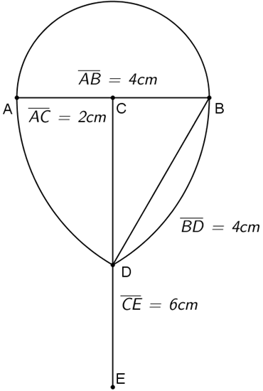
Our research
Outline
1) Our research
2) Tessellations Project as part of our research
3) Phases of the project (with examples)
4) Evaluation of the project
5) Value of the project for our research
From our previous pilot researches we have found out that…

Slide 11
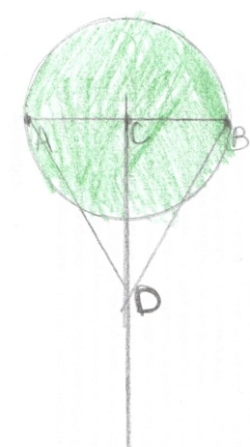
Our research
Outline
1) Our research
2) Tessellations Project as part of our research
3) Phases of the project (with examples)
4) Evaluation of the project
5) Value of the project for our research
From our previous pilot researches we have found out that…

Slide 12
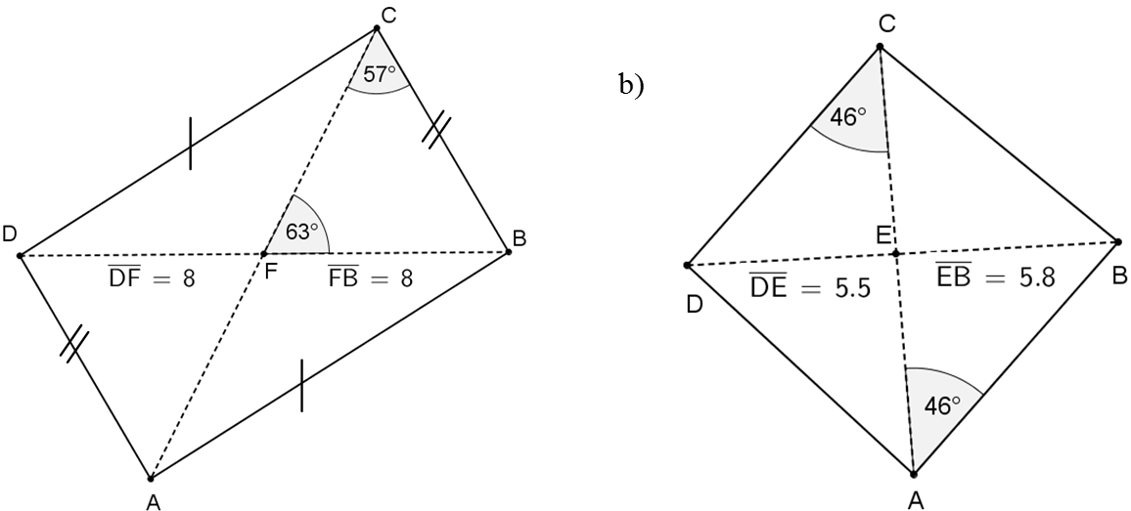
Our research
Outline
1) Our research
2) Tessellations Project as part of our research
3) Phases of the project (with examples)
4) Evaluation of the project
5) Value of the project for our research
From our previous pilot researches we have found out that…

Slide 13
Tessellations Project as part of our research
Outline
1) Our research
2) Tessellations Project as part of our research
3) Phases of the project (with examples)
4) Evaluation of the project
5) Value of the project for our research
Why students don’t understand geometrical figures?
  Possible cause could be incorrect mental representations of basic geometric elements (square, rectangle, centre, symmetry, equality, similarity, …)

Slide 14
Tessellations Project as part of our research
Outline
1) Our research
2) Tessellations Project as part of our research
3) Phases of the project (with examples)
4) Evaluation of the project
5) Value of the project for our research
Why students don’t understand geometrical figures?
  Possible cause could be incorrect mental representations of basic geometric elements (square, rectangle, centre, symmetry, equality, similarity, …)
Pilot research
  Working with geometric objects in non-standard situations
  „Reading“ important information from figures
  Making use of geometric relations

Slide 15
Tessellations Project as part of our research
Outline
1) Our research
2) Tessellations Project as part of our research
3) Phases of the project (with examples)
4) Evaluation of the project
5) Value of the project for our research
Why students don’t understand geometrical figures?
  Possible cause could be incorrect mental representations of basic geometric elements (square, rectangle, centre, symmetry, equality, similarity, …)
Pilot research
  Working with geometric objects in non-standard situations
  „Reading“ important information from figures
  Making use of geometric relations
Aims of the pilot research
  Find out whether pupils’ basic mental representations are correct
  Describe the way pupils construct and assemble geometric objects

Slide 16
Phases of the project
Outline
1) Our research
2) Tessellations Project as part of our research
3) Phases of the project (with examples)
4) Evaluation of the project
5) Value of the project for our research
Task
  Design a tessellation from geometric objects, construct it in GeoGebra and cut enough cardboard pieces to cover your desk.
Phases of the project
  practice – revision of necessary
  GeoGebra
  manufacturing of the tessellations and evaluation – team work

Slide 17
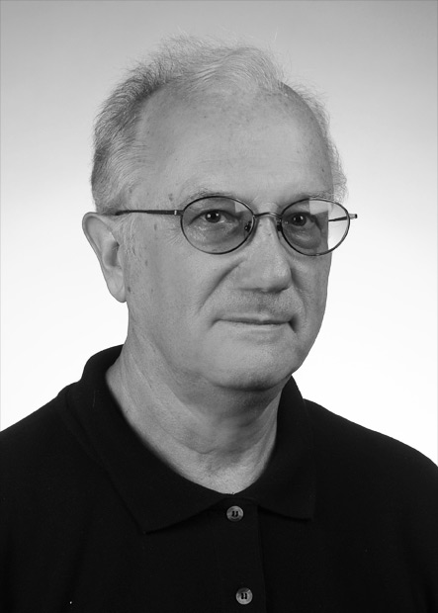
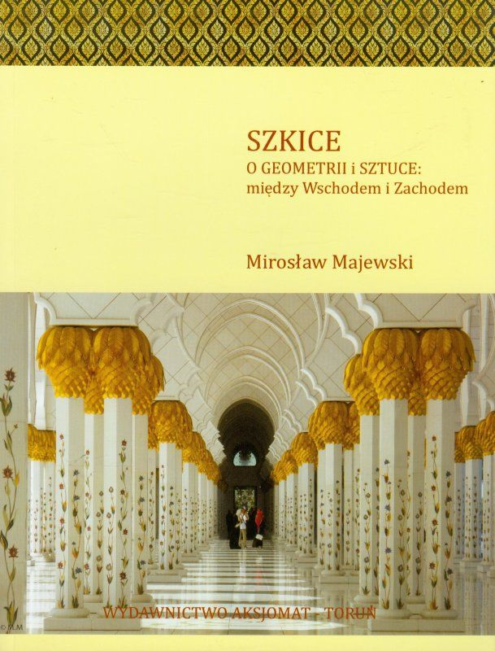
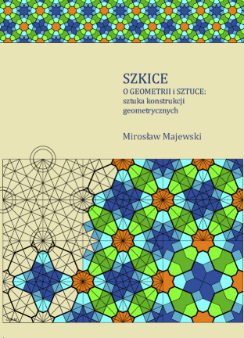
Motivation
Outline
1) Our research
2) Tessellations Project as part of our research
3) Phases of the project (with examples)
4) Evaluation of the project
5) Value of the project for our research
Szkice. O geometrii i sztuce między Wschodem i Zachodem
Majewski Mirosław

Slide 18
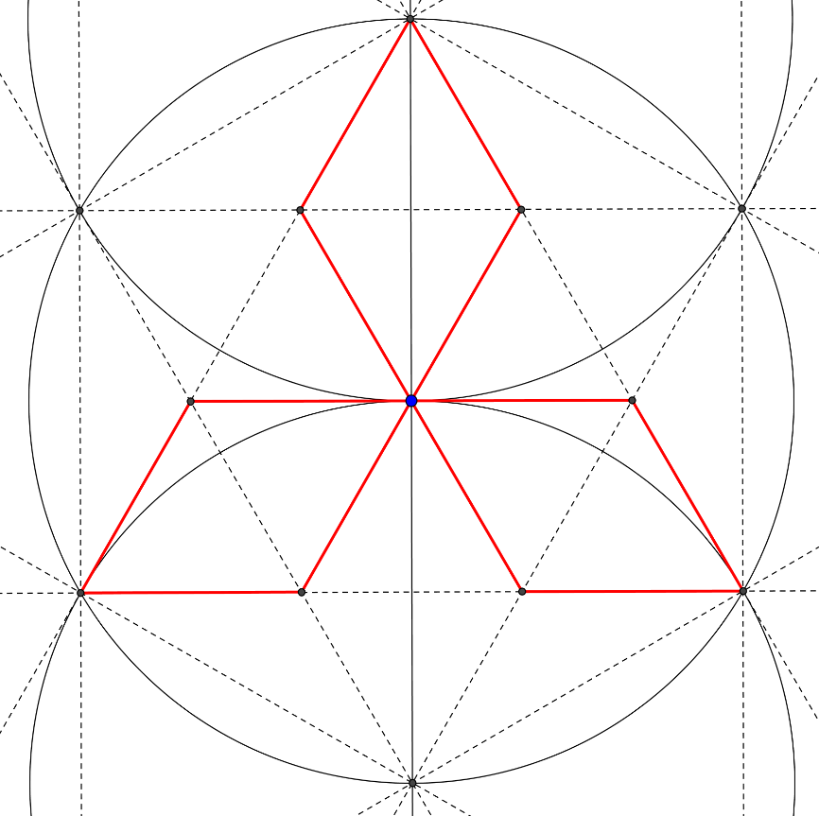
Training

Slide 19
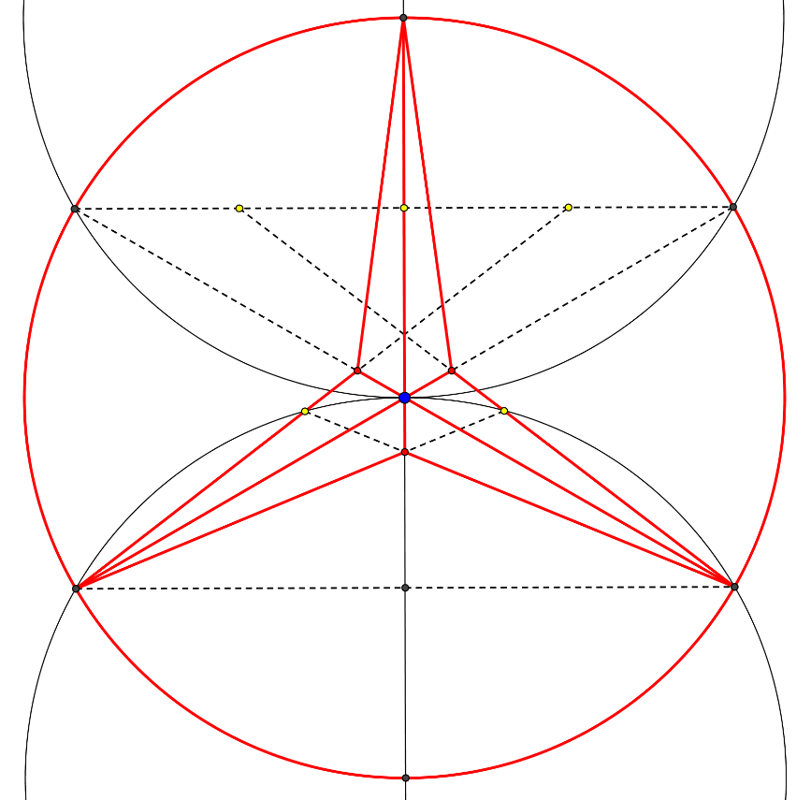
Training

Slide 20
Training

Slide 21
Training

Slide 22
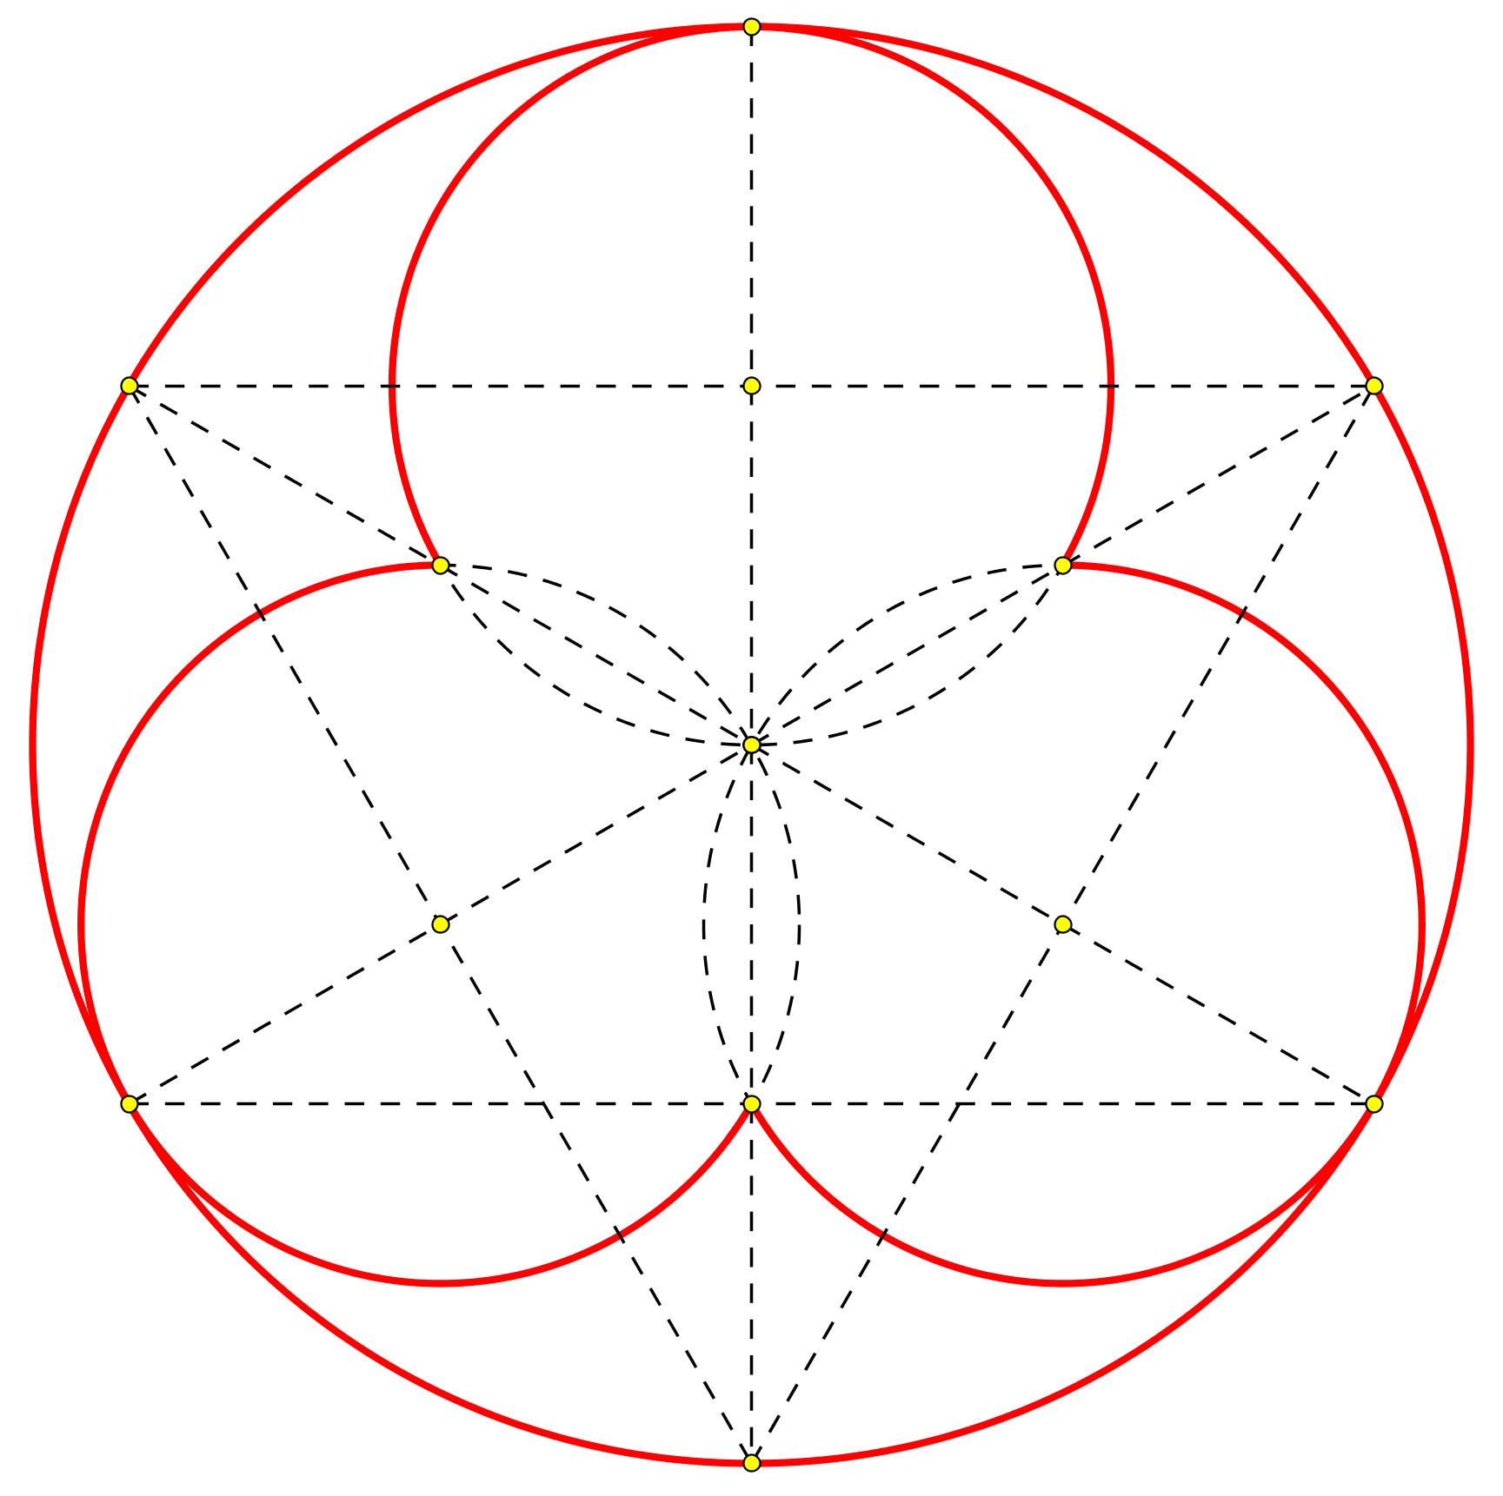

Training

Slide 23
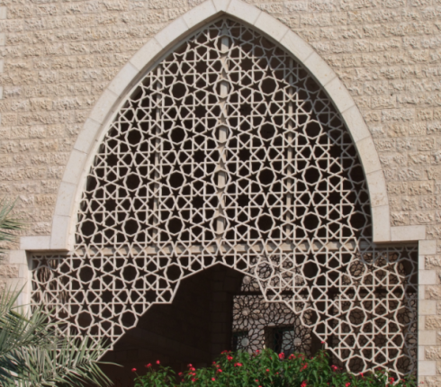
Training

Slide 24
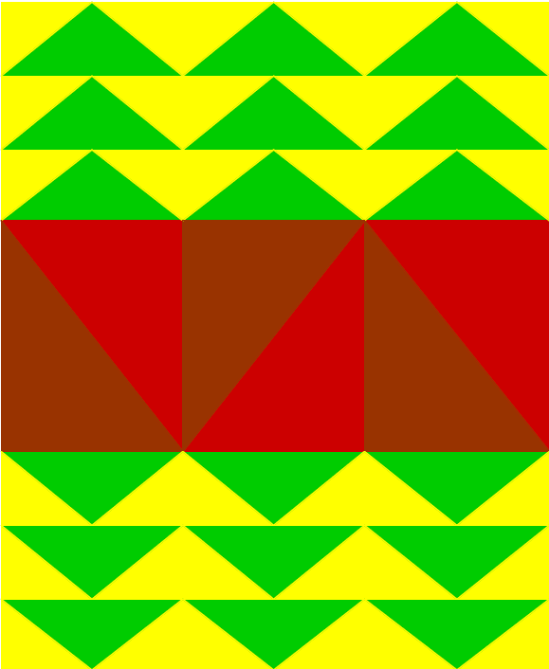
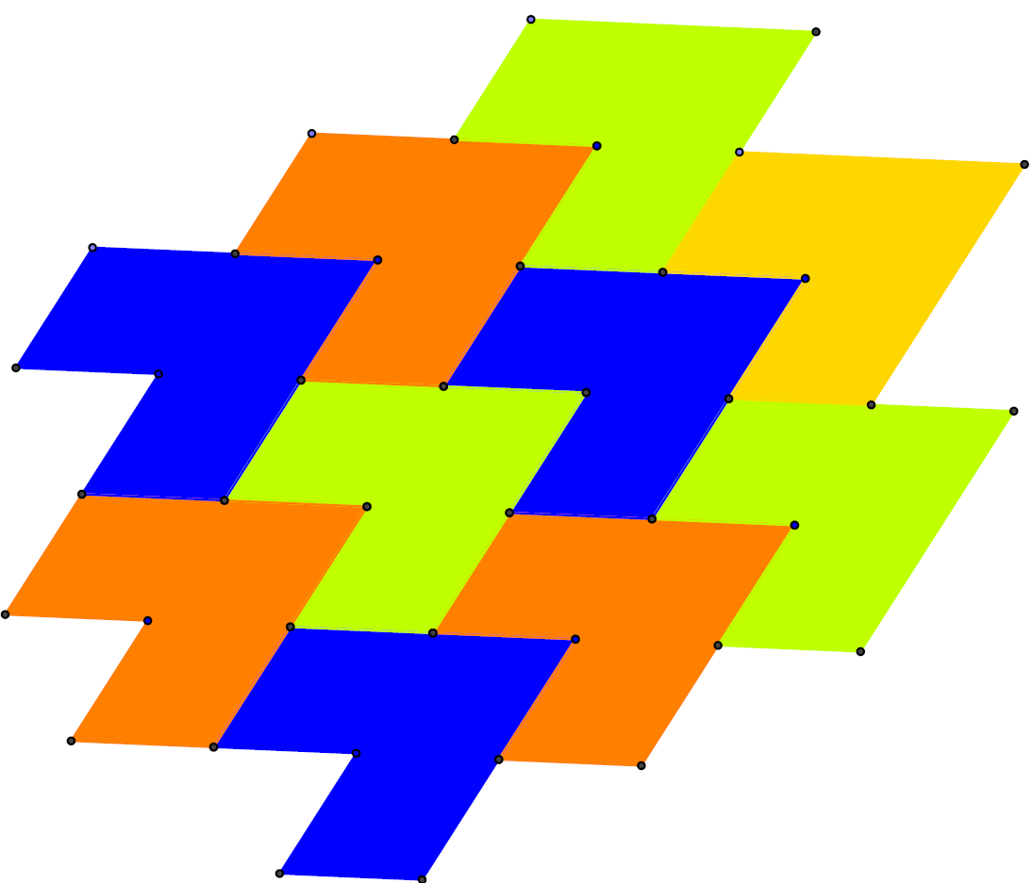
Working with GeoGebra
Lucie, 14 years

Slide 25
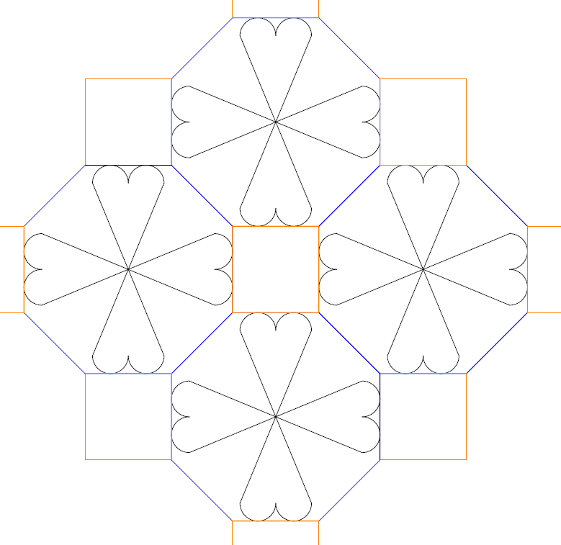
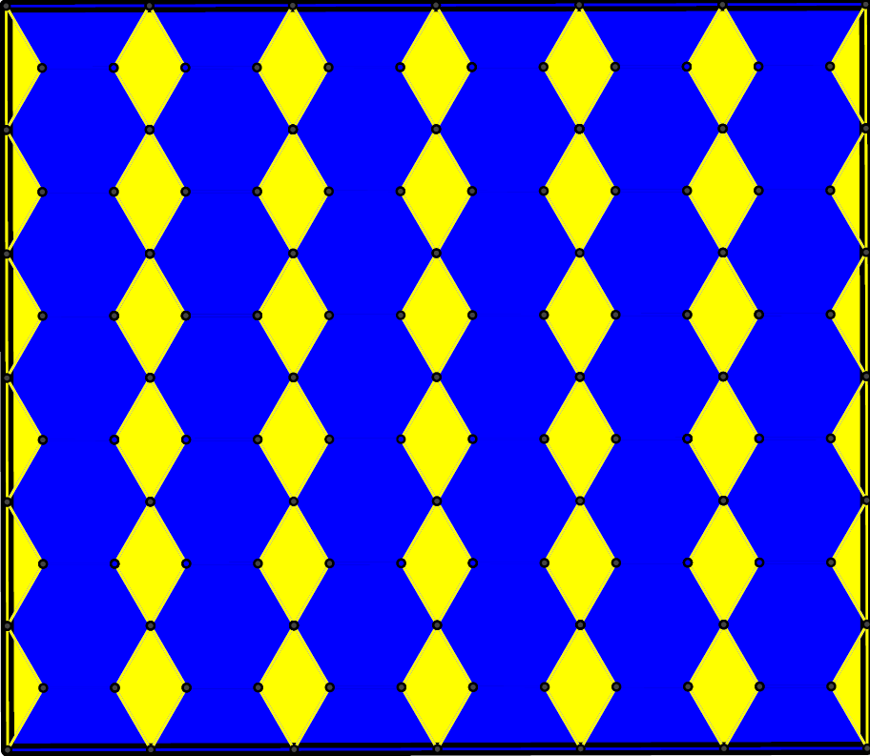
Working with GeoGebra
Tereza, 15 years

Slide 26
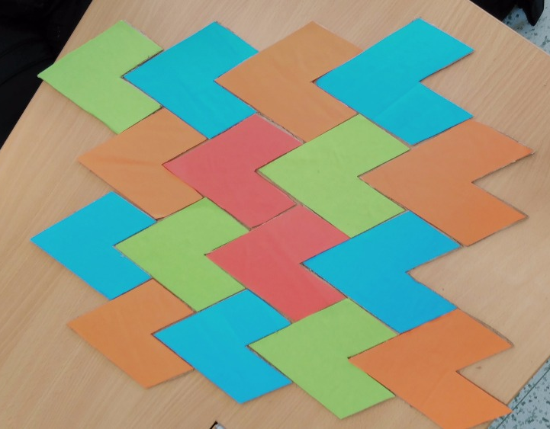
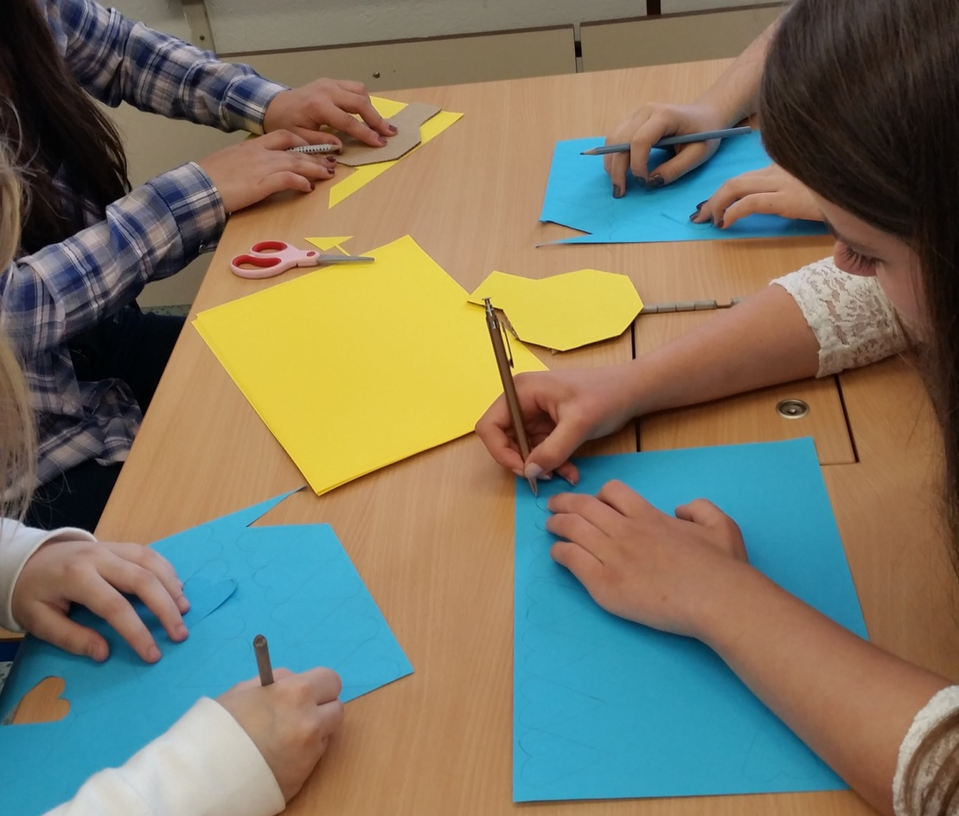
Manufacturing of tessellations

Slide 27
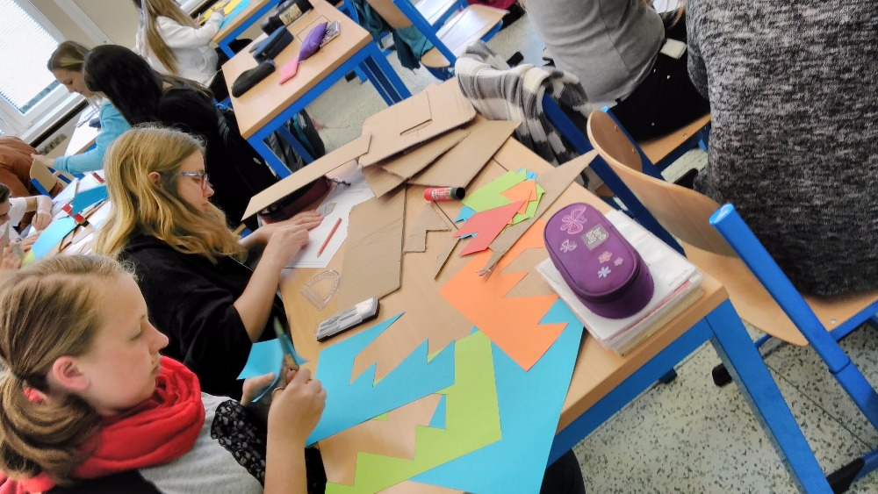
Manufacturing of tessellations

Slide 28
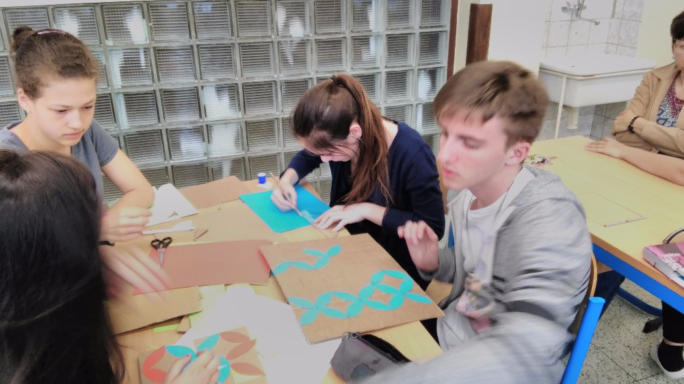
Manufacturing of tessellations

Slide 29
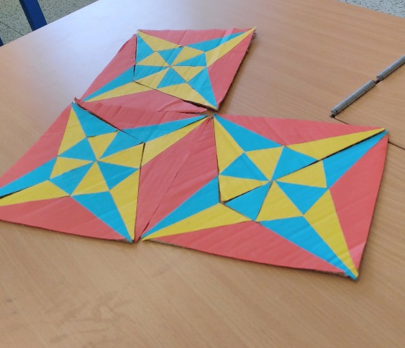
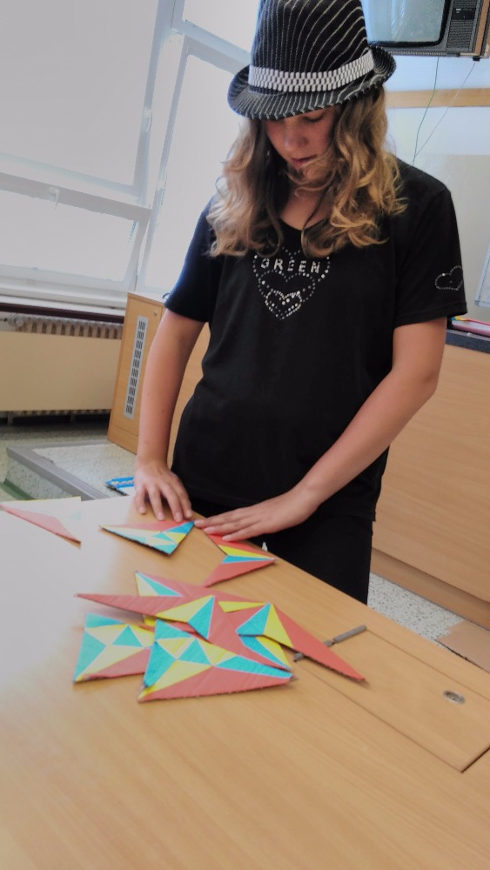
Manufacturing of tessellations
Kamila, 15 years (Asperger syndrome)

Slide 30
Evaluation
Outline
1) Our research
2) Tessellations Project as part of our research
3) Phases of the project (with examples)
4) Evaluation of the project
5) Value of the project for our research
Knowledge
Originality
Precision
Art
Team-work

Slide 31
Evaluation
Outline
1) Our research
2) Tessellations Project as part of our research
3) Phases of the project (with examples)
4) Evaluation of the project
5) Value of the project for our research
Knowledge
Originality
Precision
Art
Team-work
Pupils had problem follow the drawn instruction in the practice phase.
Construction in GeoGebra was more difficult than paper and pencil method.

Slide 32
Evaluation
Outline
1) Our research
2) Tessellations Project as part of our research
3) Phases of the project (with examples)
4) Evaluation of the project
5) Value of the project for our research
Knowledge
Originality
Precision
Art
Team-work
Pupils’ work was creative and original in most cases.

Slide 33
Evaluation
Outline
1) Our research
2) Tessellations Project as part of our research
3) Phases of the project (with examples)
4) Evaluation of the project
5) Value of the project for our research
Knowledge
Originality
Precision
Art
Team-work
Some pupils were unable to find precise midpoint of a segment in GeoGebra.
Pupils’ constructions were not precise and the mistake had increasing tendency.

Slide 34
Evaluation
Outline
1) Our research
2) Tessellations Project as part of our research
3) Phases of the project (with examples)
4) Evaluation of the project
5) Value of the project for our research
Knowledge
Originality
Precision
Art
Team-work
Four of seven groups finished their tessellation.

Slide 35
Evaluation
Outline
1) Our research
2) Tessellations Project as part of our research
3) Phases of the project (with examples)
4) Evaluation of the project
5) Value of the project for our research
Knowledge
Originality
Precision
Art
Team-work
Three groups did not finish their work because of ineffective team-work.

Slide 36
Eight key competences
Outline
1) Our research
2) Tessellations Project as part of our research
3) Phases of the project (with examples)
4) Evaluation of the project
5) Value of the project for our research
Some key competences of the pupils have been developed during the project:
communication in the mother tongue
communication in foreign languages
mathematical competence and basic competences in science and technology
digital competence
learning to learn
social and civic competences
sense of initiative and entrepreneurship
cultural awareness and expression

Slide 37
Eight key competences
Outline
1) Our research
2) Tessellations Project as part of our research
3) Phases of the project (with examples)
4) Evaluation of the project
5) Value of the project for our research
Some key competences of the pupils have been developed during the project:
communication in the mother tongue
communication in foreign languages
mathematical competence and basic competences in science and technology
digital competence
learning to learn
social and civic competences
sense of initiative and entrepreneurship
cultural awareness and expression

Slide 38
Benefits for teachers
Outline
1) Our research
2) Tessellations Project as part of our research
3) Phases of the project (with examples)
4) Evaluation of the project
5) Value of the project for our research
Revision of geometry topics from 6th to 9th grade
  regular polygons
  isometries
GeoGebra makes pupils think in a different way
  intersections
  circle, perpendicular line, axes
Efficient manufacturing of tessellations
  pupils did not use mathematics to make their work easier. They constructed each peace of tessellations separately.

Slide 39
Value of the project for our research
Outline
1) Our research
2) Tessellations Project as part of our research
3) Phases of the project (with examples)
4) Evaluation of the project
5) Value of the project for our research
Conclusions of the pilot researches:
One third of pupils has problems to „read“ geometric objects.
Constructions in GeoGebra require deeper understanding of geometric objects.
Inefficient manufacturing of tessellations by pieces is a sign of insufficient insight into the geometrical structure of the tessellation. Most pupils did not make use of their knowledge during the construction.

Slide 40
Vă mulțumesc pentru atenție

