Slide 1
Obstacles in combining the use of various tools in solving mathematical problems – why is Copy/Paste often useless
Matija Lokar
Faculty of mathematics and physics, University of Ljubljana
Matija.Lokar@fmf.uni-lj.si
Paul Libbrecht
PH Weingarten, Weingarten, Germany
paul@hoplahup.net

Slide 2
CADGME 2014
Talk Lessons Learned in Course Computer Tools In Mathematics
We talked (also) about
One tool covering all aspects of teaching and learning mathematics, or many "smaller" tools
Interoperability of tools

Slide 3
Course Computer Tools In Mathematics
Practical Mathematics
First cycle professional study program
Emphasis on hands on solving "old mathematical tasks" (from high school) with various tools (Mathematica, GeoGebra, Octave, Excel, Numpy …)
Subject specific competences developed by the student:
ability of employment of mathematical tools at practical problem solving,
ability of result analysis,
ability of presentation of results
…

Slide 4
Experiment
Having chosen different widespread software programs, students explored transfers of mathematical object between them using copy and paste.

Slide 5
Background
In the first weeks in the course Computer tools in mathematics students get used to some typical examples of mathematical software.
They obtained mostly just the basic knowledge, so they know only the most common functions and functionality of the used applications
Experiment: To solve (and to report in detail the process of obtaining the solution) a certain mathematical task
The usage (within the same task) of different mathematical software has been foreseen
Had to report on all difficulties and obstacles

Slide 6
Example
Given are points A, B, C and D. Construct a cubic polynomial p(x) through those points. Use GeoGebra to draw it. Select arbitrary point (x, p(x)) and draw a tangent to the graph. To calculate the polynomial, use suitable procedure in OCTAVE. Report about the process, describe steps, justify your findings
Report also about the obstacles, difficulties and your impressions when doing this task!

Slide 7
Exchange of mathematical objects
Work with several systems of mathematical software
Reporting
Copy / Paste procedure is expected to be used by students

Slide 8
Copy and paste from the technical point of view
An origin „place“ is selected (e.g. with the mouse)
It is copied
several copies of the content into the system’s clipboard,
one for each flavor, in order of preference.
A target place is selected in a document being edited.
The contents of the clipboard is pasted.
The application editing that document chooses the best flavor
inserts its associated content at the given place.

Slide 9
Some „real life“ cases

Slide 10
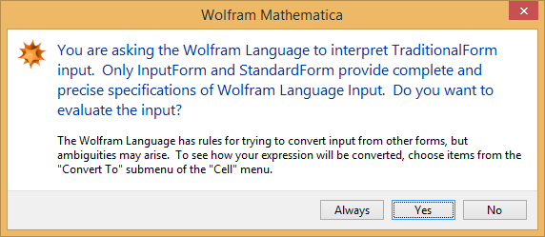
From Word to Mathematica
Word (Equation mode)
Insert > Equation
marking the expression
Ctrl-C (the copy operation)
Mathematica
Ctrl-V (Paste)

Slide 11
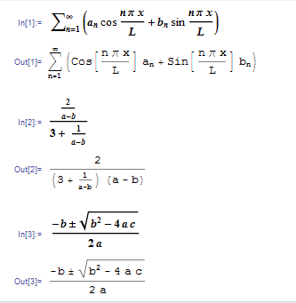
Many examples perform well

Slide 12
But …

Slide 13
What about text mode …
Problems with auto format
6-b becomes 6 – b (dash!)
1/4 becomes ¼

Slide 14
From Mathematica to Word
Problems with peculiarities of Mathematica’s syntax like [] for functions' arguments
Word –Mathematica - Word

Slide 15
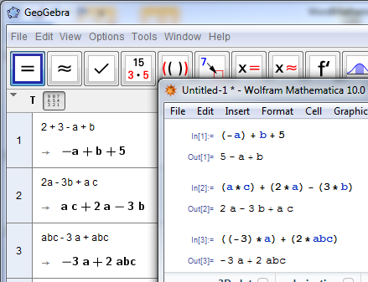
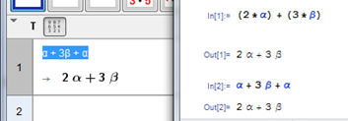
GeoGebra and Mathematica
GeoGebra CAS mode!

Slide 16
But in opposite direction

Slide 17
Also with Copy as …
Copy as MathML

Slide 18
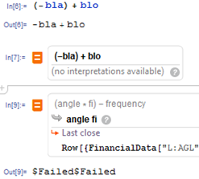
Free form input In Mathematica

Slide 19
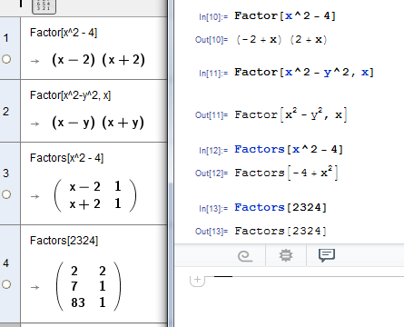
Commands with (almost) the same name, but …

Slide 20
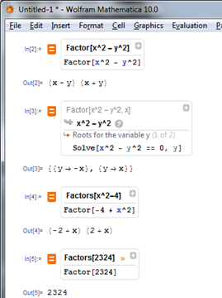
Using FreeForm

Slide 21
Matrices from Octave to Mathematica

Slide 22
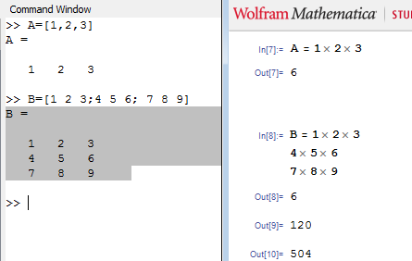
Or using defined vector/matrix

Slide 23
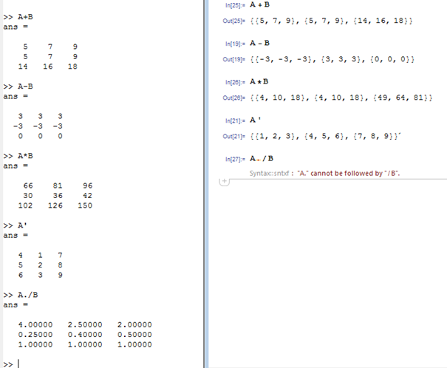
Operations

Slide 24
Observations and remarks

Slide 25
“... Copy/Paste method does not work with drawing plots in different programs. For drawing plots each one of used programs has its own ‘language’, which we have to use. “

Slide 26
“When we copied expressions from Word to GeoGebra, it worked in some cases even without changing expressions. If exponents would be written with symbol ‘^’ in Word, there would not be any problems. From there on, some changes and adaptations were necessary, especially when copying expressions from GeoGebra to Mathematica”

Slide 27
“... I was very rarely able to use Copy/Paste method to transfer expressions between programs and even then some corrections were usually needed for programs to work”

Slide 28
“After several tries I gave up. The only way to transfer an expression between programs is to manually retype it …”

Slide 29
“To input matrix in X is surprisingly identical to input matrix in Y. But unfortunately here the joy ends.”

Slide 30
“It has been an extremely tough task. I spent numerous hours doing it. I tried several techniques to force the program to properly copy/paste the expression with no success. Finally, I manually transferred the expressions. But here I had problems again as even the usage of parenthesis not even mentioning the names of the commands was not the same. I do not understand why software producers each one uses their own syntax.”

Slide 31
“Please do not give us such tasks anymore. It is impossible. All the time switching between different syntax. At the end I did not even know, if I got everything right, even though the mathematics behind was luckily simple enough.”

Slide 32
And finally

Slide 33
“it is all mathematical software and mathematics is just one, so I expected no problems in using Copy/Paste”
In the discussion afterwards they all express their deep disappointment with the software. When started the task, they mostly all expected there will be no problems or just some minor problems.

Slide 34
Multiple issues
Loss of information at copying
Preference for pasting plain text when other formats may be more appropriate
Misinterpretation of the mathematical notation
Lack of usage of more semantic encodings
Partial but unpredictable success

Slide 35
Loss of information at copying
some programs transfer much of the information into the clipboard
allowing other programs to recover most information (in principle),
many put information in private encodings
difficult for other applications to receive in a consistent manner on the long term.

Slide 36
Preference for pasting plain text when other formats may be more appropriate
many programs ignore content types
that could bring more information
expecting that plain text is probably a better guess than, MathML, RTF, or HTML flavors

Slide 37
Misinterpretation of the mathematical notation
input of mathematical formulæ leaves the user quite free to use mathematical notations in different ways
usage of the cross-sign for multiplications (fails in C/P Word to Mathematica).
different software use different function names which are not properly exchanged

Slide 38
Lack of usage of more semantic encodings
Most mathematical sofftware systems include a rich set of mathematical operators and functions.
interoperability they offer
linear syntax (known to be very program-specific)
presentation-oriented syntax (such as MathML presentation or pictures).

Slide 39
Partial but unpredictable success
very diverse set of interoperability issues.
no way to explain rules to tell when a formula will be transferred successfully.

